Slide 1
Graph

Slide 2
Graph
Graph is a data structure that consists of following two components:
1. A finite set of vertices also called as nodes.
2. A finite set of ordered pair of the form (u, v) called as edge.
The pair is ordered because (u, v) is not same as (v, u) in case of directed graph(di-graph). The pair of form (u, v) indicates that there is an edge from vertex u to vertex v. The edges may contain weight/value/cost.

Slide 3
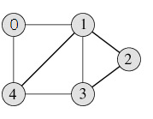
Example
Following is an example undirected graph with 5 vertices.

Slide 4
Applications of Graph
Graphs are used to represent networks. The networks may include paths in a city or telephone network or circuit network.
Graphs are also used in social networks like linkedIn, facebook. For example, in facebook, each person is represented with a vertex(or node). Each node is a structure and contains information like person id, name, gender, etc.

Slide 5
Graph Representation
The two most common representations of Graph are:-
Adjacency Matrix
Adjacency List
There are other representations also like, Incidence Matrix and Incidence List. The choice of the graph representation is situation specific. It totally depends on the type of operations to be performed and ease of use.

Slide 6
Adjacency Matrix
Adjacency Matrix is a 2D array of size V x V where V is the number of vertices in a graph.
Let the 2D array be adj[][], a slot adj[i][j] = 1 indicates that there is an edge from vertex i to vertex j.
Adjacency matrix for undirected graph is always symmetric.
Adjacency Matrix is also used to represent weighted graphs. If adj[i][j] = w, then there is an edge from vertex i to vertex j with weight w.

Slide 7
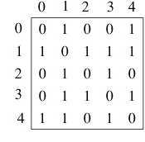
Example
Adjacency Matrix for the undirected graph with 5 vertices.

Slide 8
Pros and Cons of Adjacency Matrix
Pros:
1. Representation is easier to implement and follow.
2. Removing an edge takes O(1) time.
3. Queries like whether there is an edge from vertex ‘u’ to vertex ‘v’ are efficient and can be done O(1).
Cons:
Consumes more space O(V²).
Even if the graph is sparse(contains less number of edges), it consumes the same space.
Adding a vertex is O(V²) time.

Slide 9
Adjacency List
An array of linked lists is used.
Size of the array is equal to number of vertices.
Let the array be array[]. An entry array[i] represents the linked list of vertices adjacent to the i^{th} vertex.
This representation can also be used to represent a weighted graph. The weights of edges can be stored in nodes of linked lists.

Slide 10
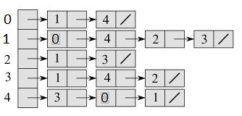
Example
Adjacency List for the undirected graph with 5 vertices.

Slide 11
Breadth First/Depth First Traversal of a Graph

Slide 12
BFS vs DFS for Binary Tree
What are BFS and DFS for Binary Tree?
A Tree is typically traversed in two ways:
Breadth First Traversal (Or Level Order Traversal)
Depth First Traversals
  Inorder Traversal (Left-Root-Right)
  Preorder Traversal (Root-Left-Right)
  Postorder Traversal (Left-Right-Root)

Slide 13
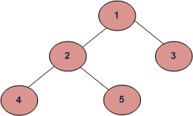
BFS vs DFS for Binary Tree
Breadth First Traversal : 1 2 3 4 5
Depth First Traversals:
Preorder Traversal : 1 2 4 5 3
Inorder Traversal : 4 2 5 1 3
Postorder Traversal : 4 5 2 3 1

Slide 14
BFS vs DFS for Binary Tree
All four traversals require O(n) time as they visit every node exactly once.
There is difference in terms of extra space required.
Extra Space required for Level Order Traversal is O(w) where w is maximum width of Binary Tree. In level order traversal, queue stores nodes of different level.
Extra Space required for Depth First Traversals is O(h) where h is maximum height of Binary Tree. In Depth First Traversals, stack stores all ancestors of a node.

Slide 15
Breadth First Traversal for a Graph
Breadth First Traversal for a graph is similar to Breadth First Traversal of a tree.
Unlike trees, graphs may contain cycles, so we may come to the same node again.
To avoid processing a node more than once, we use a boolean visited array. For simplicity, it is assumed that all vertices are reachable from the starting vertex.

Slide 16
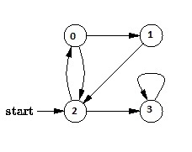
Breadth First Traversal for a Graph
For example, in the following graph, we start traversal from vertex 2. When we come to vertex 0, we look for all adjacent vertices of it. 2 is also an adjacent vertex of 0. If we don’t mark visited vertices, then 2 will be processed again and it will become a non-terminating process. A Breadth First Traversal of the following graph is 2, 0, 3, 1.

Slide 17
Breadth First Traversal Algorithm
The BFS algorithm works as follows:
Start by putting any one of the graph's vertices at the back(rear) of a queue.
Take the front item of the queue and add it to the visited list.
Create a list of that vertex's adjacent nodes. Add the ones which aren't in the visited list to the back (rear) of the queue.
Keep repeating steps 2 and 3 until the queue is empty.

Slide 18
Depth First Traversal for a Graph
Depth First Traversal for a graph is similar to Depth First Traversal of a tree.
Unlike trees, graphs may contain cycles, so we may come to the same node again.
To avoid processing a node more than once, we use a boolean visited array.

Slide 19
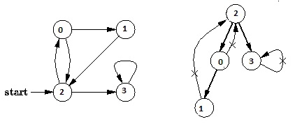
Depth First Traversal for a Graph
For example, in the following graph, we start traversal from vertex 2. When we come to vertex 0, we look for all adjacent vertices of it. 2 is also an adjacent vertex of 0. If we don’t mark visited vertices, then 2 will be processed again and it will become a non-terminating process. A Depth First Traversal of the following graph is 2, 0, 1, 3.

Slide 20
Depth First Traversal Algorithm
The DFS algorithm works as follows:
Start by putting any one of the graph's vertices on top of a stack.
Take the top item of the stack and add it to the visited list.
Create a list of that vertex's adjacent nodes. Add the ones which aren't in the visited list to the top of stack.
Keep repeating steps 2 and 3 until the stack is empty.

Slide 21
Applications of Depth First Search
For an unweighted graph, DFS traversal of the graph produces the minimum spanning tree and all pair shortest path tree.
2) Detecting cycle in a graph
A graph has cycle if and only if we see a back edge during DFS. So we can run DFS for the graph and check for back edges.

Slide 22
Detecting cycle in a graph
Depth First Traversal can be used to detect cycle in a Graph. DFS for a connected graph produces a tree. There is a cycle in a graph only if there is a back edge present in the graph. A back edge is an edge that is from a node to itself (selfloop) or one of its ancestor in the tree produced by DFS. In the following graph, there are 3 back edges, marked with cross sign. We can observe that these 3 back edges indicate 3 cycles present in the graph.
Directed Graph containing no cycles is called Directed Acyclic Graph (DAG).

Slide 23
Applications of Depth First Search
3) Path Finding
We can specialize the DFS algorithm to find a path between two
given vertices u and z.
Call DFS(G, u) with u as the start vertex.
Use a stack S to keep track of the path between the start
vertex and the current vertex.
iii) As soon as destination vertex z is encountered, return the path as the contents of the stack

Slide 24
Applications of Depth First Search
4) Topological Sorting
Let S be a directed graph without cycles (or a partially ordered set). A topological sort T of S is a linear ordering of the nodes of S which preserves the original partial ordering of S. That is: if u < v in S (i.e., if there is a path from u to v in S), then u comes before v in the linear ordering T.

Slide 25
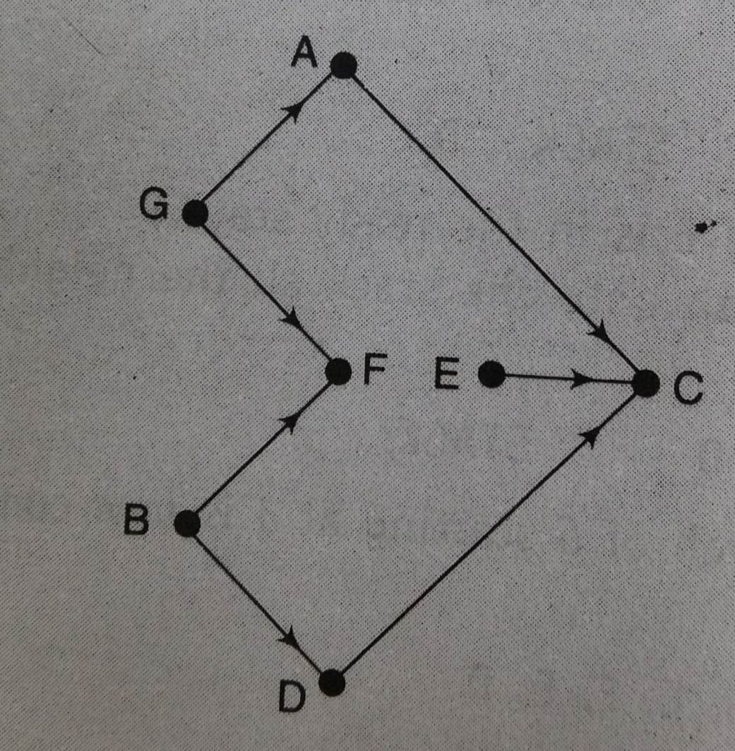
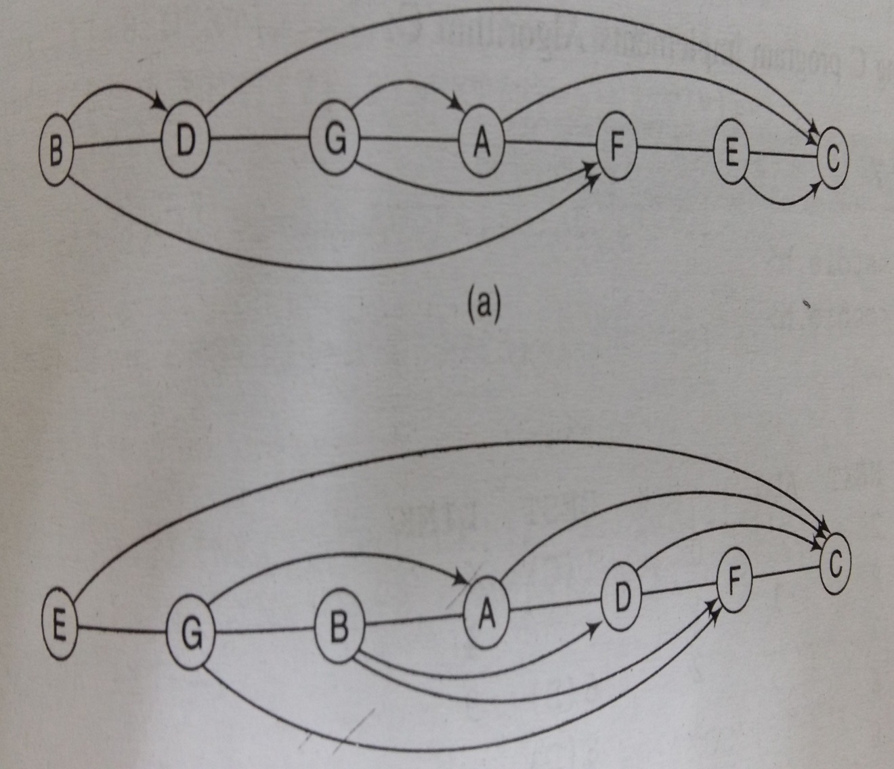
Applications of Depth First Search
Topological Sorting of the given graph

Slide 26
Applications of Depth First Search
5) To test if a graph is bipartite
We can augment either BFS or DFS when we first discover a new vertex, color it opposited its parents, and for each other edge, check it doesn’t link two vertices of the same color. The first vertex in any connected component can be red or black!

Slide 27
Applications of Depth First Search
6) Finding Strongly Connected Components of a graph
A directed graph is called strongly connected if there is a path from each vertex in the graph to every other vertex.
7) Solving puzzles with only one solution, such as mazes. (DFS can be adapted to find all solutions to a maze by only including nodes on the current path in the visited set.)

Slide 28
Applications of Breadth First Search
Shortest Path and Minimum Spanning Tree for unweighted graph
In unweighted graph, the shortest path is the path with least number of edges. With Breadth First, we always reach a vertex from given source using minimum number of edges. Also, in case of unweighted graphs, any spanning tree is Minimum Spanning Tree and we can use either Depth or Breadth first traversal for finding a spanning tree.
2) Peer to Peer Networks.
In Peer to Peer Networks like BitTorrent, Breadth First Search is used to find all neighbor nodes.

Slide 29
Applications of Breadth First Search
3) Crawlers in Search Engines: Crawlers build index using Bread First. The idea is to start from source page and follow all links from source and keep doing same. Depth First Traversal can also be used for crawlers, but the advantage with Breadth First Traversal is, depth or levels of built tree can be limited.
4) Social Networking Websites: In social networks, we can find people within a given distance ‘k’ from a person using Breadth First Search till ‘k’ levels.

Slide 30
Applications of Breadth First Search
5) GPS Navigation systems: Breadth First Search is used to find all neighboring locations.
6) Broadcasting in Network: In networks, a broadcasted packet follows Breadth First Search to reach all nodes.
7) In Garbage Collection: Breadth First Search is used in copying garbage collection using Cheney’s algorithm. Breadth First Search is preferred over Depth First Search because of better locality of reference.

Slide 31
Algorithm to check if a graph is Bipartite
Assign RED color to the source vertex (putting into set U).
2. Color all the neighbors with BLUE color (putting into set V).
3. Color all neighbor’s neighbor with RED color (putting into set U).
4. This way, assign color to all vertices.
5. While assigning colors, if we find a neighbor which is colored with same color as current vertex, then the graph cannot be colored with 2 vertices (or graph is not Bipartite)

